Slide 1

Presentation
University at Buffalo
Marcellus Lecture Series
Gary Marchiori
President
EnergyMark, LLC

Slide 2



Agenda May 5, 2011
Hydraulic Fracturing
Energy Demand
Energy Supply
Pipeline Overview
New Energy Flow Patterns

Slide 3
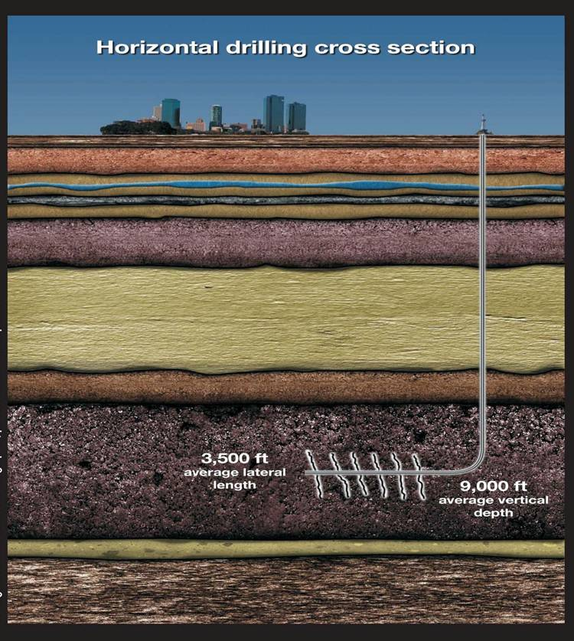
Hydraulic Fracturing
New York Times examines the process of hydro-fracturing.
Notes:
1- A temporary drilling rig is used to drill a vertical well that goes several thousand feet deep and then turns horizontally. It is removed once the well is completed.
2- Once the water table is reached, cement is poured to seal the well from the ground water.
3- The well continues vertically until the shale formation is reached. It then travels horizontally through the shale for several thousand feet.
4- A perforating gun is used to piece the pipe and cement where natural gas is trapped.
5- A mixture of pressurized water and additives is used to widen the shale’s fractures.
6- Natural pressure forces the liquids back through the pipe to the surface.
7- Natural gas flows from the fractures in the shale into the pipe and to the surface.
8- As the fluid recedes, sand grains or ceramic pellets remain in the fractures, holding them open so pressurized gas can escape and rise up through the well.

Slide 4

Energy Demand
Overall Energy Use
US Nat Gas Consumption
A Look at End Users
Fuel for Power Generation
Trends

Slide 5


Slide 6
Gas Industry Sales Customers (Thousands)
65,147,000 End Users
Source: AGA

Slide 7
US Natural Gas Consumption
20,827 Trillion Btu’s
Source: AGA

Slide 8
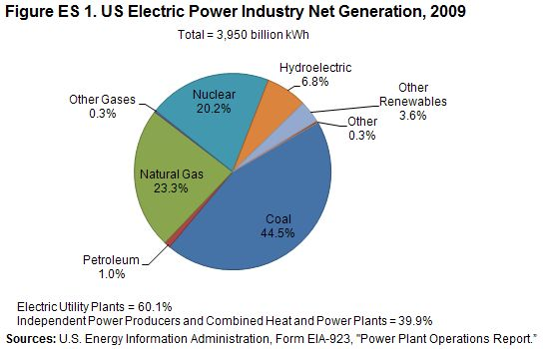

Slide 9
Electric Generation Natural Gas Consumption
Source: AGA

Slide 10
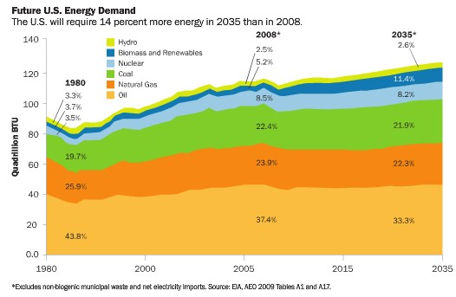
Growing Need for Energy

Slide 11
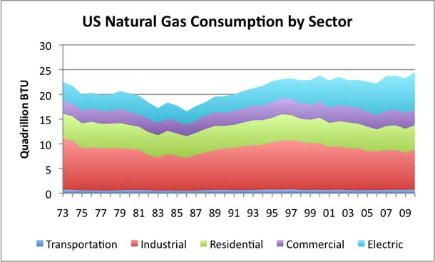
U.S. Demand by Sector
Source: EIA

Slide 12
U.S. Northeast Demand
Source: TransCanada

Slide 13
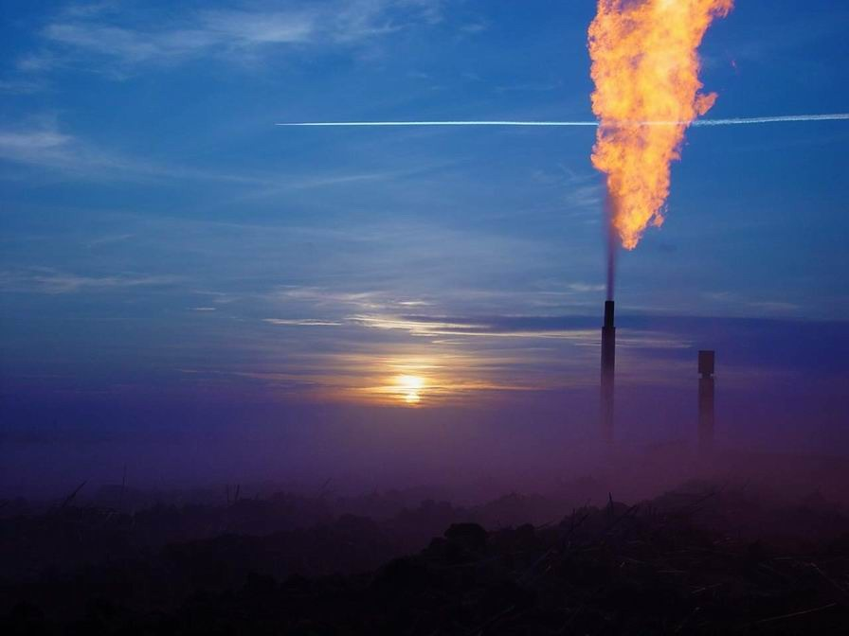
Energy SUPPLY
Supply
Sources
Production by region
Exports / Imports
Net Imports
Growth in Shale production

Slide 14
U.S. Sources of NG Supply

Slide 15
U.S. NG Production by Region
Notes:
** Key take away:
Most of the gas comes from 3 -4 places
Note importance of US Gulf Coast

Slide 16
Exports of Natural Gas From the United States
Source: AGA

Slide 17
Pipeline Imports of Natural Gas to the U.S.
Source: AGA

Slide 18
U.S. Net Imports
Source: EIA Annual Energy Outlook 2008

Slide 19
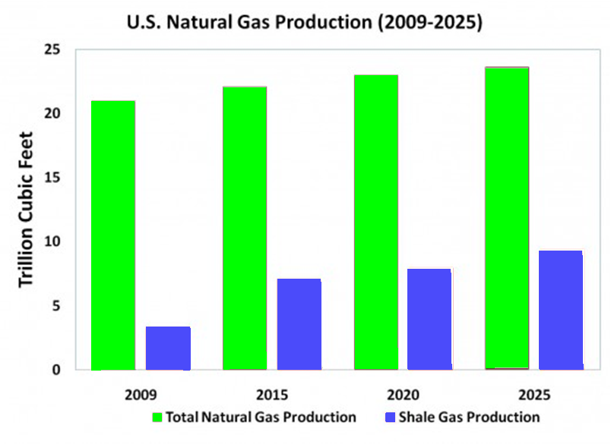

Slide 20
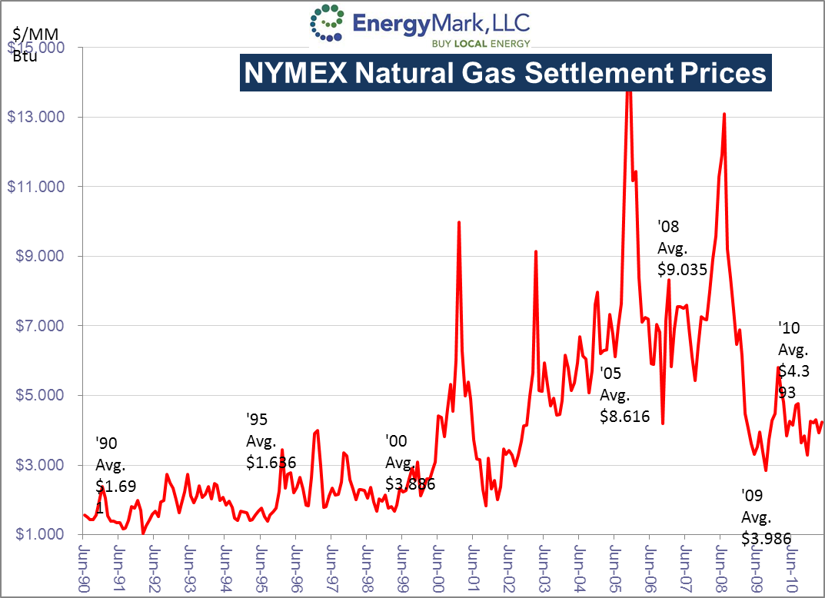

Slide 21
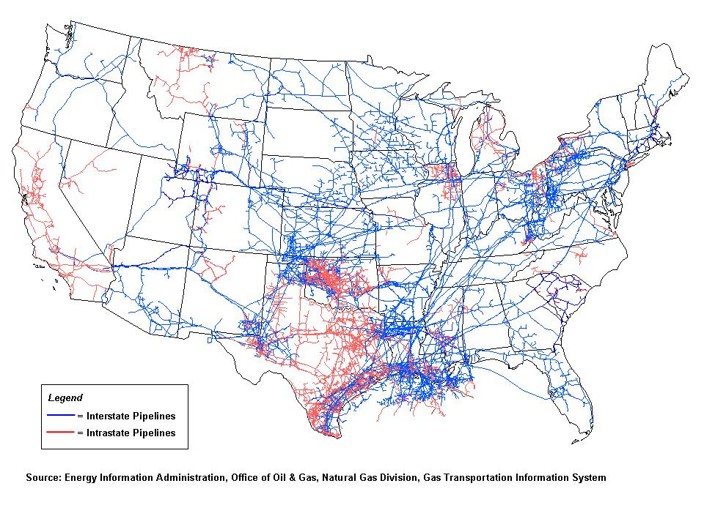
Pipeline Overview

Slide 22
Distribution and Transmission Miles of Pipeline
2,392,600 Miles
Source: AGA

Slide 23
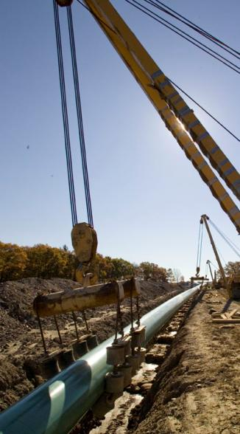
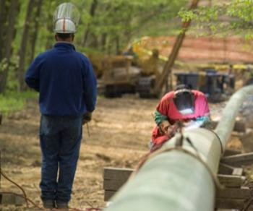
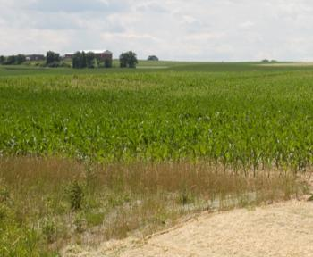
Distribution Miles of Main by State (2009)
State | Miles
New Jersey | 33,247
New York | 47,484
Pennsylvania | 47,134
Middle Atlantic Total = | 127,865
Source: AGA and NFGS

Slide 24
U.S. Miles of Main by Material
Source: AGA

Slide 25
U.S. Number of Services by Material
Source: AGA

Slide 26
Natural Gas Pipeline Safety
The majority of accidents were from excavators who failed do their research, fire/explosions, or vehicles striking above-ground facilities.
The portion titled “other” were related to 21 different types of incidents.
There was a total of only 1,261 accidents between 1995 and 2004
Source: AGA

Slide 27
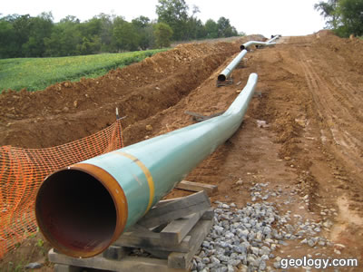
Long Haul Interstate Pipelines - East
Tennessee
Transcontinental
Texas Eastern

Slide 28
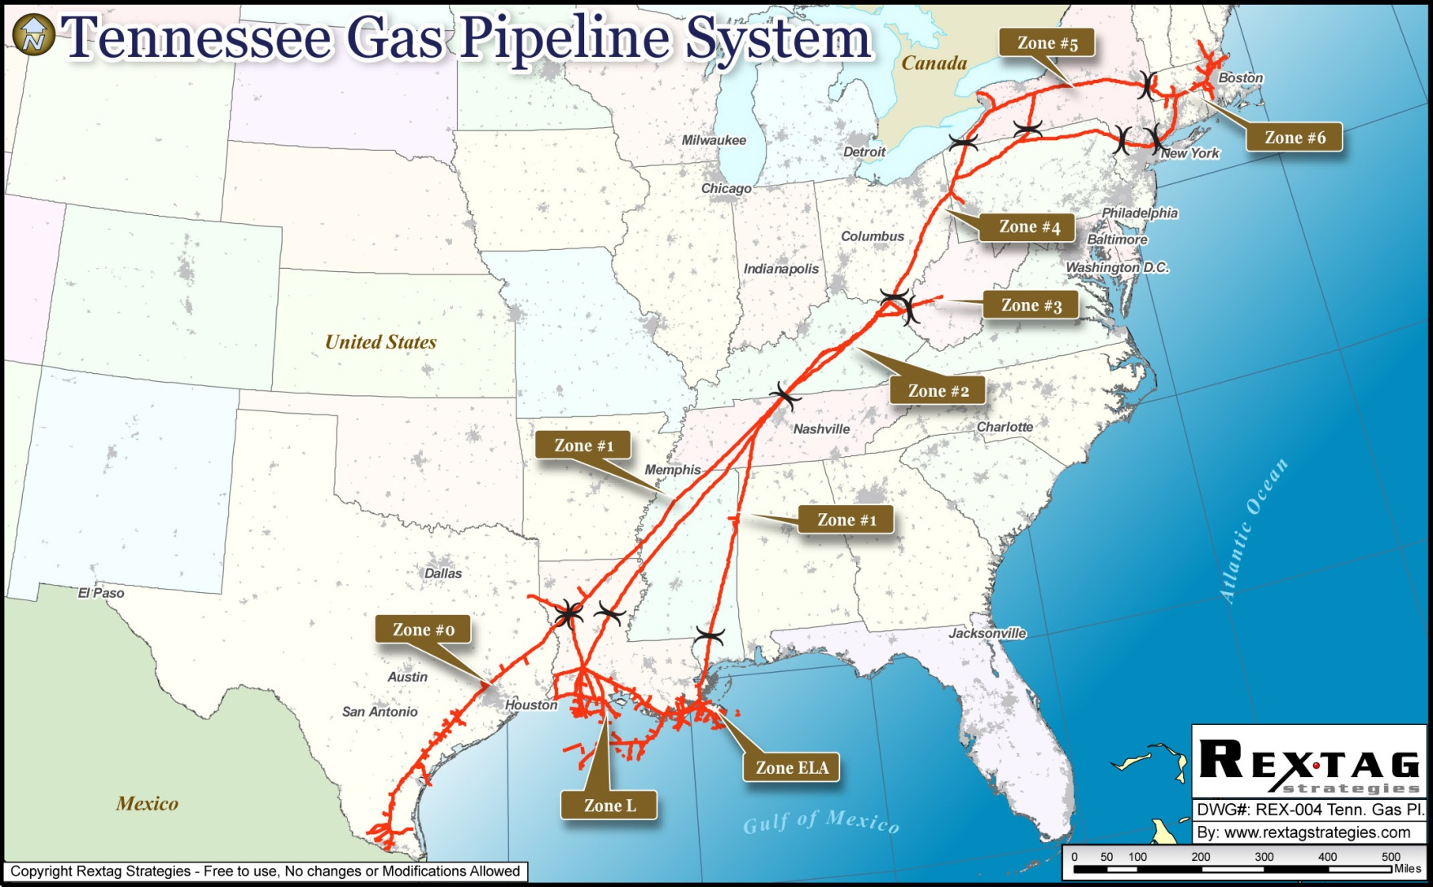
Tennessee

Slide 29
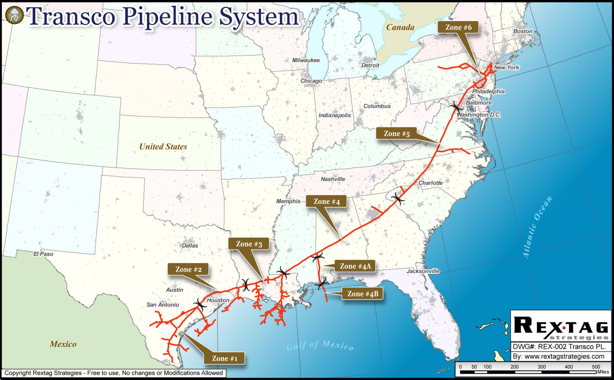
Transco

Slide 30
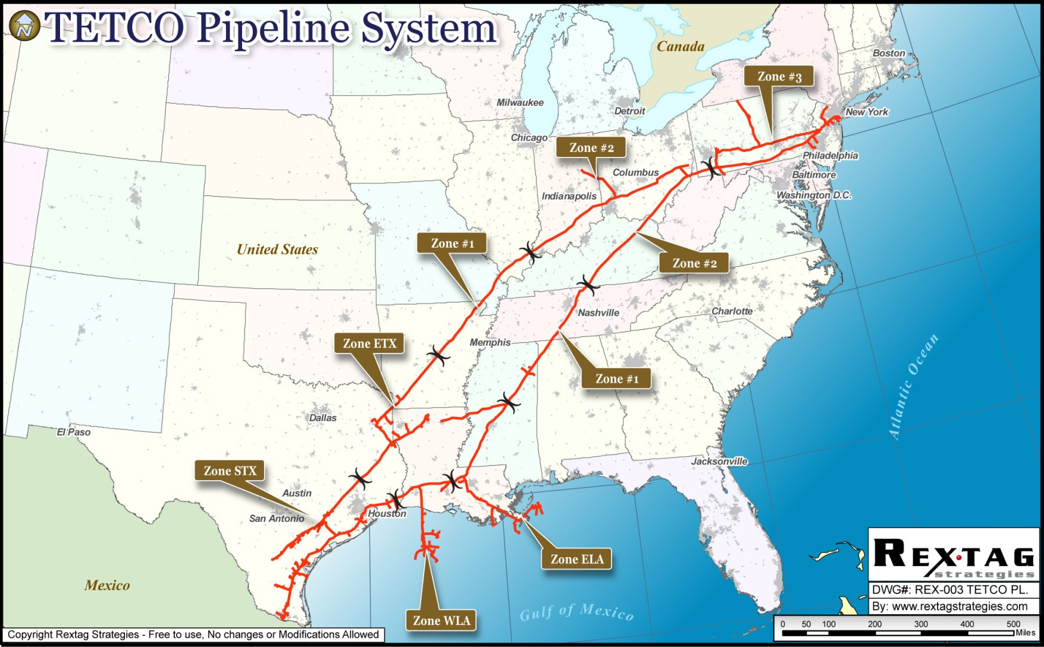
Tetco

Slide 31
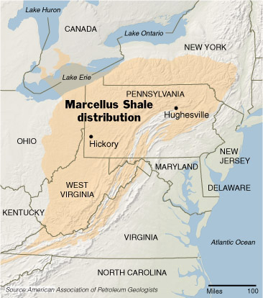
Regional Pipeline Systems
Columbia
Dominion
Iroquois
National Fuel Gas Supply/ Empire

Slide 32
= Marcellus Shale area

Slide 33
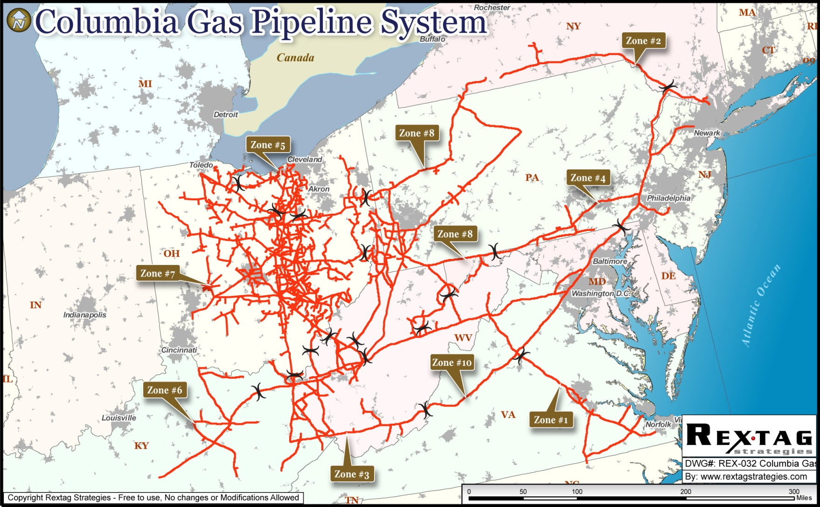
Columbia

Slide 34
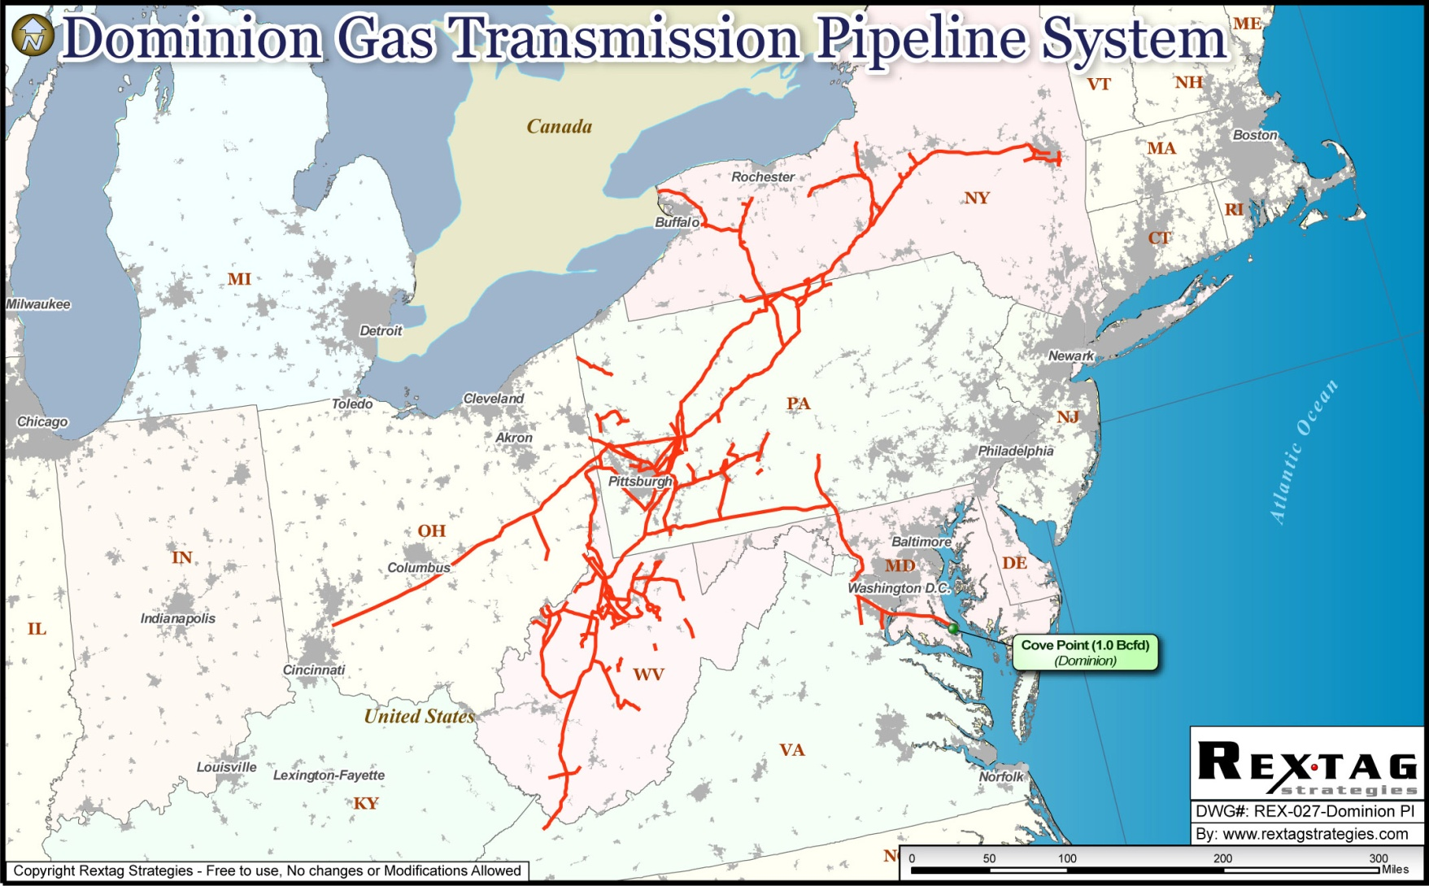
Dominion

Slide 35
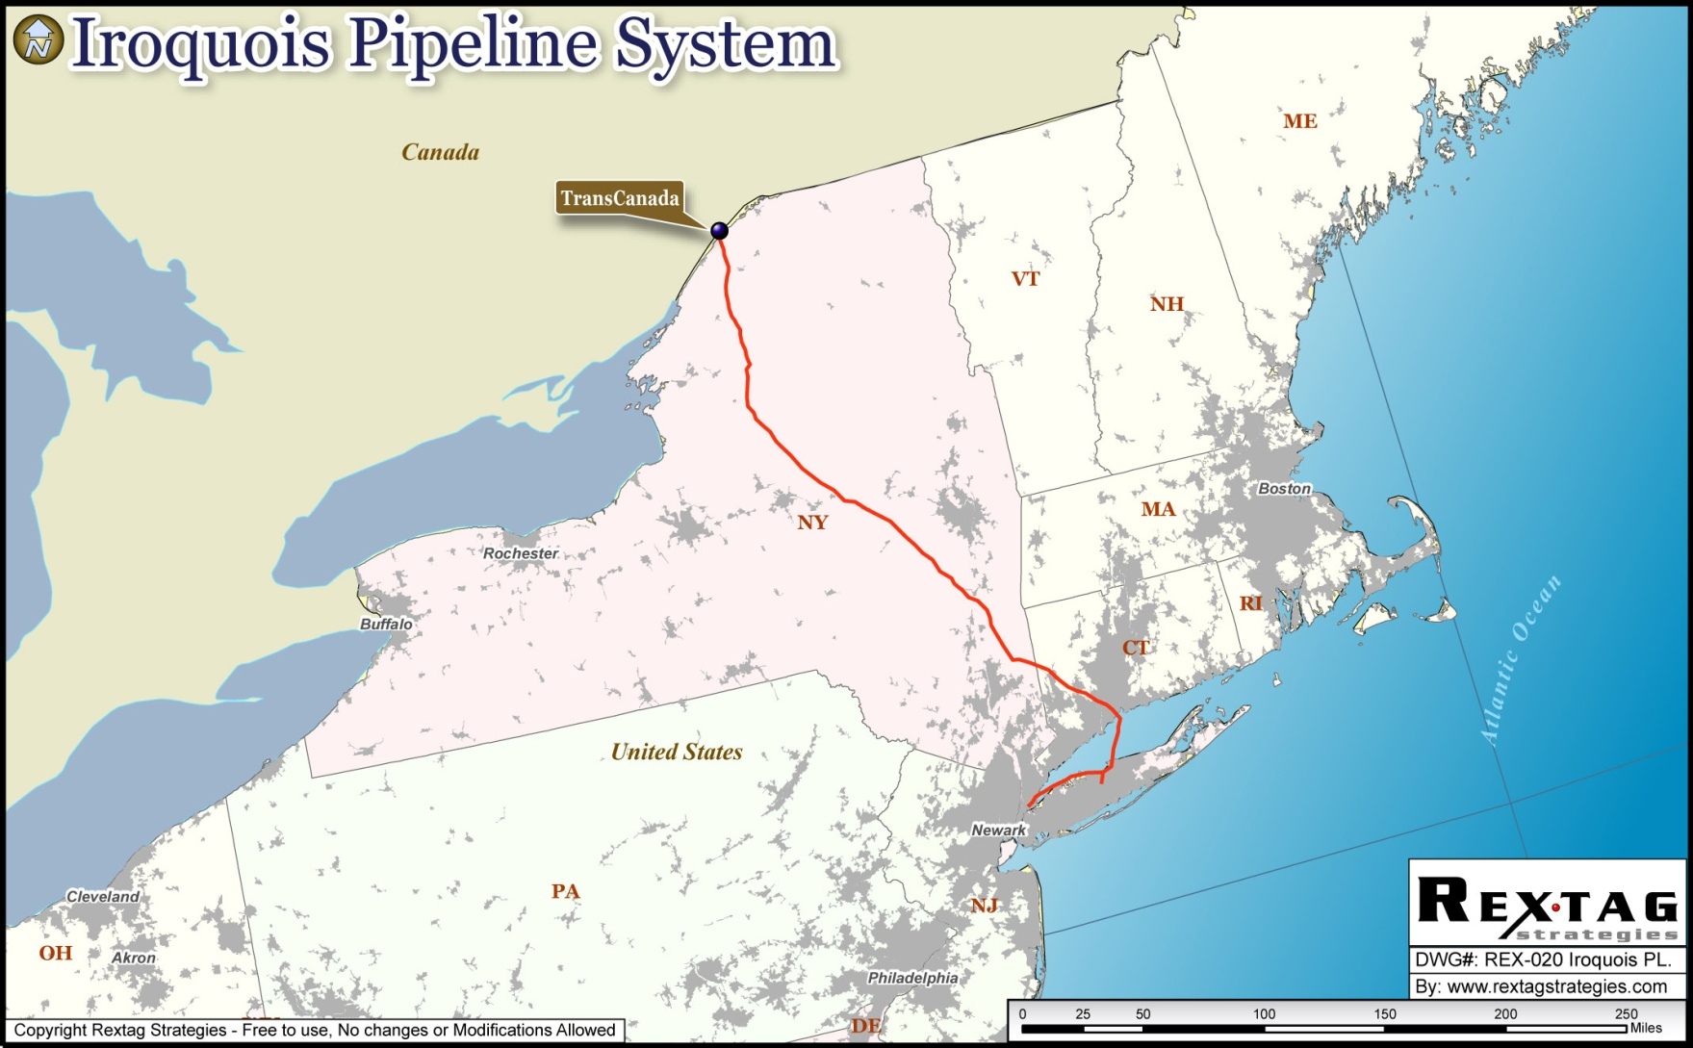
Iroquois

Slide 36
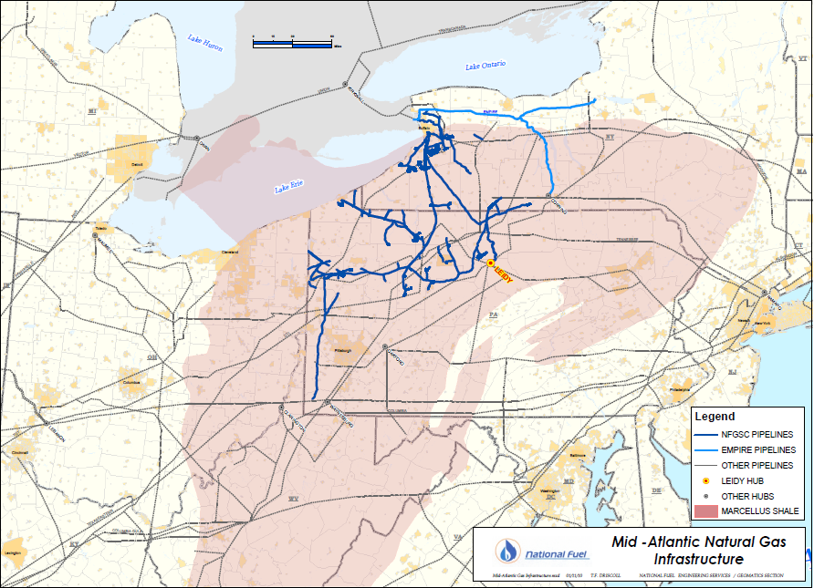
Mid – Atlantic Region
Notes:
Shows how our system overlays the Marcellus; good lead-in to the discussion of our projects. Illustrates why we’re doing what we’re doing…
Just to answer the ONE question everyone has on their mind. Although our pipeline grid is decades old, we most certainly DID know all along bout the potential of the Marcellus and we’re just now reaping the benefits

Slide 37
National Fuel Gas Pipeline & Storage System
Lake Ontario
Lake Ontario
Lake Ontario
TCPL
Niagara
Empire Pipeline
Niagara, Chippawa
CANADA
Chippawa
Empire Connector
CANADA
Corning
Empire, Millennium
Lake
Lake
Lake
Corning
Erie
Erie
Erie
Independence
5 Line
A
-
Millennium
NY
Tuscarora
NY
Storage
PA
Ellisburg
PA
Ellisburg Interconnects:
TGP, DTI
Leidy
Leidy: DTI,
Transco, TETCO
National Fuel Gas
Bristoria
NFGSC System Storages
TETCO M2
NFGSC System Pipelines
OH
PA
Empire Pipeline
OH
PA
Interconnects

Slide 38
New Pipeline Flow Patterns
Rockies Gas
Reversal of traditional flow paths
Supply to Eastern Canada

Slide 40
Price Trends Reflect Location
Bentek Energy

Slide 41
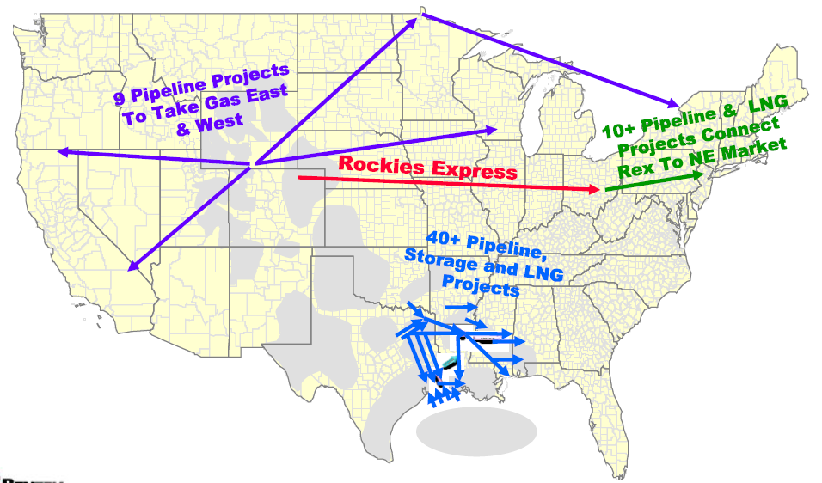
Billions Invested to Increase Access to Connect New Production
Source: Bentek Energy

Slide 42
Western Canadian Exports
Source: TransCanada

Slide 43
Prudhoe Bay to Alberta Hub
Source: TransCanada

Slide 44
New Rockies Capacity Options
Source: TransCanada

Slide 45
Moving Rockies Supply
Source: www.kindermorgan.com

Slide 46
Rockies Express Pipeline - Kinder Morgan

Slide 47
Northeast Express
Source: Kinder Morgan

Slide 48
Tennessee Gas Pipeline - Northeast Passage (NEP) Project

Slide 49
Spectra – Time II to NJ

Slide 50
Marcellus Shale Play

Slide 51
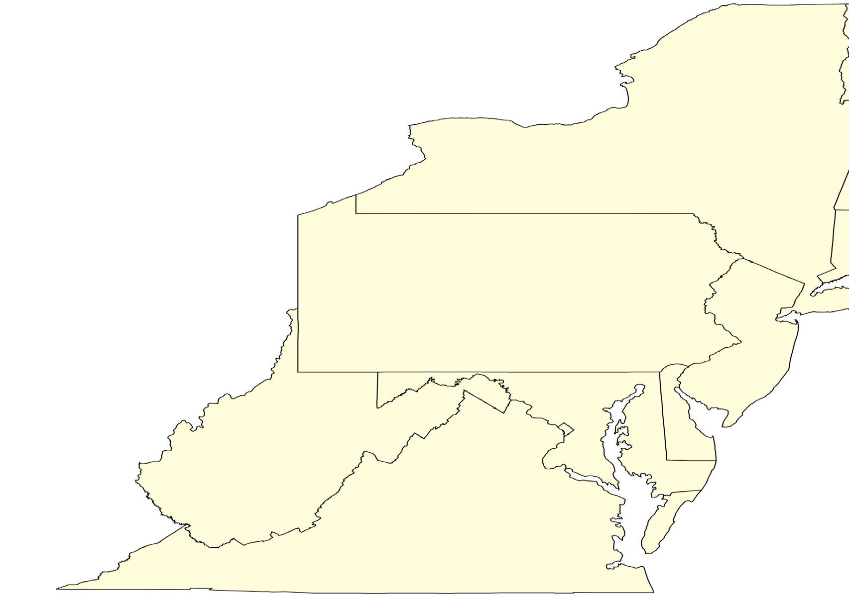
Pre-Marcellus Gas Supply Sources to the Northeast
ONTARIO
Traditionally gas supply sources have come from Canada, the Rockies, and the Gulf Coast Region.
NIAGARA
New York
LEIDY
Pennsylvania
Source: NFGS

Slide 52
Post-Marcellus Gas Supply Sources to the Northeast
ONTARIO
Marcellus Shale has resulted in the traditional gas supply being displaced.
NIAGARA
New York
LEIDY
Pennsylvania
Source: NFGS

Slide 53
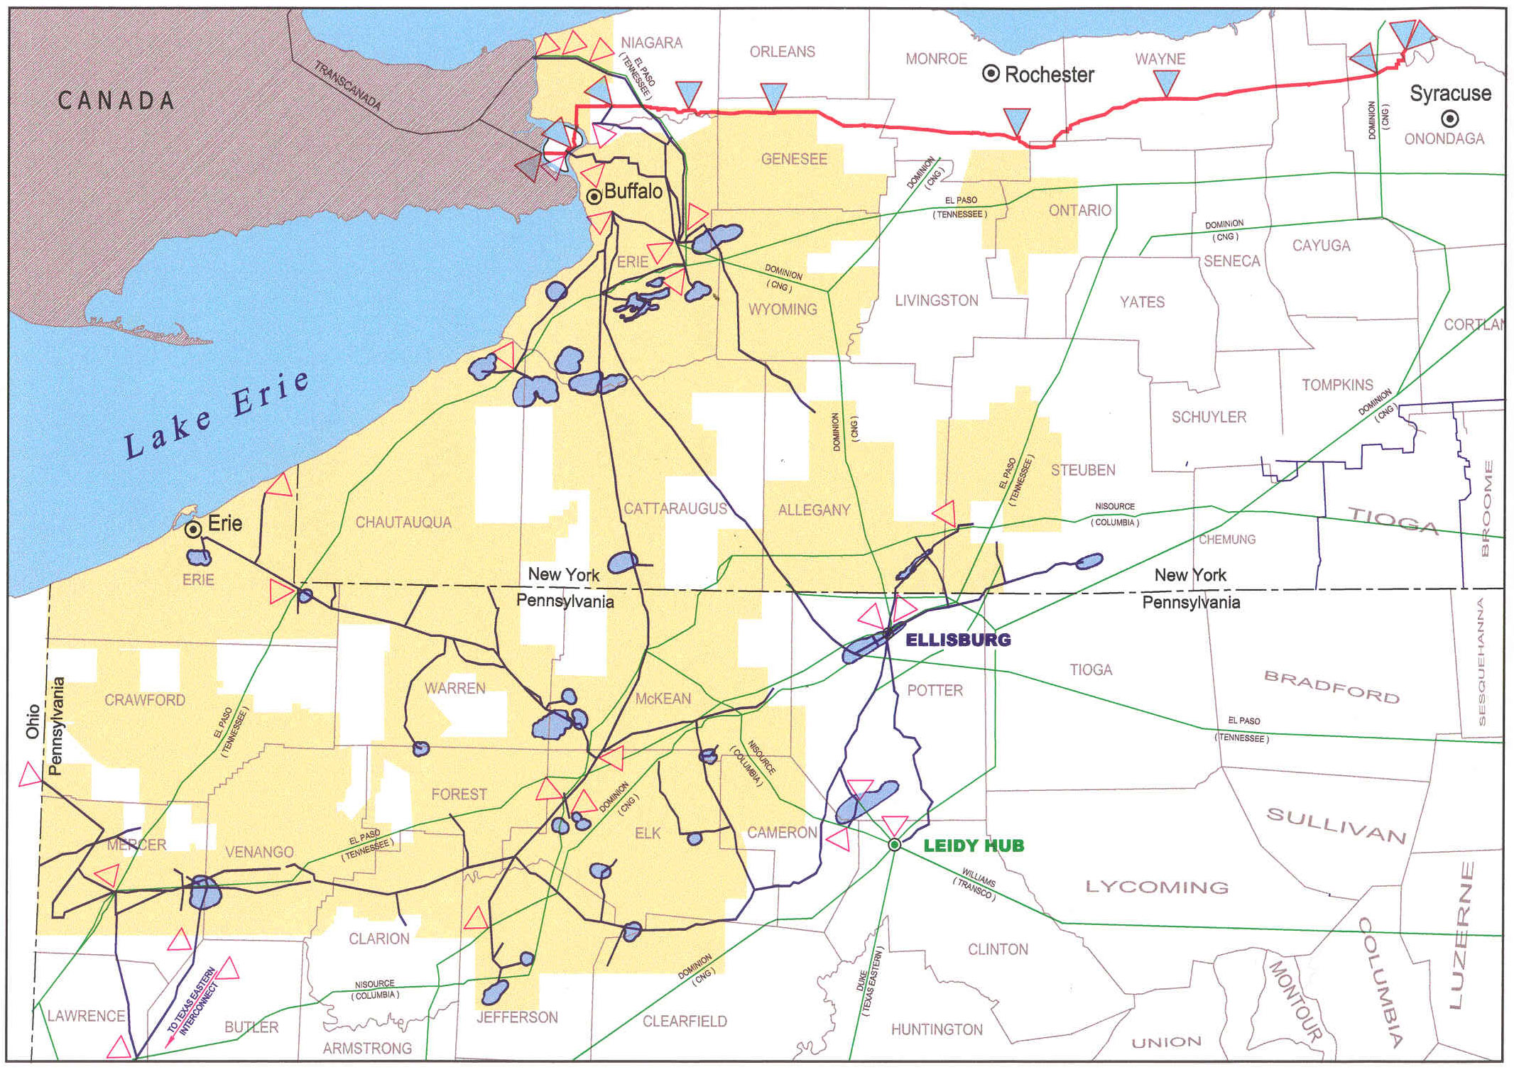
National Fuel Supply - Storage Expansion
East Branch & Galbraith

Slide 54
How millennium Fits In

Slide 55
Northeast Market Flow Changes

Slide 56
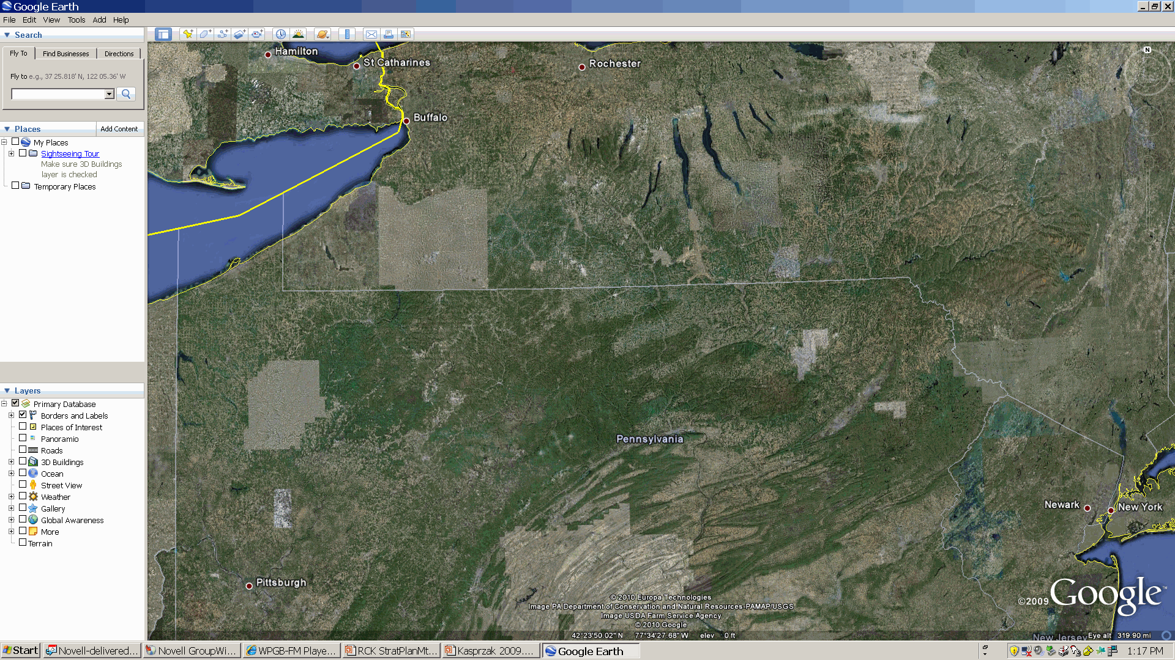
Northern Access Expansion
Niagara
Lockport
C
C
East Aurora
C
Concord
New York
Erie
Ellisburgh
C
Marcellus Shale
Leidy
Opportunity:
Reverse Flow of NFGSC System to take advantage of market pricing changes
Transport Marcellus production for Statoil to TransCanada Pipeline at Niagara.
Pennsylvania

Slide 57
West to East - Overbeck to Leidy
New York
Erie
Marcellus Shale
Leidy
C
C
C
C
Opportunity:
Transport Marcellus production for Seneca and other producers, to Transco, Tetco, and DTI at Leidy.
Pennsylvania

Slide 58
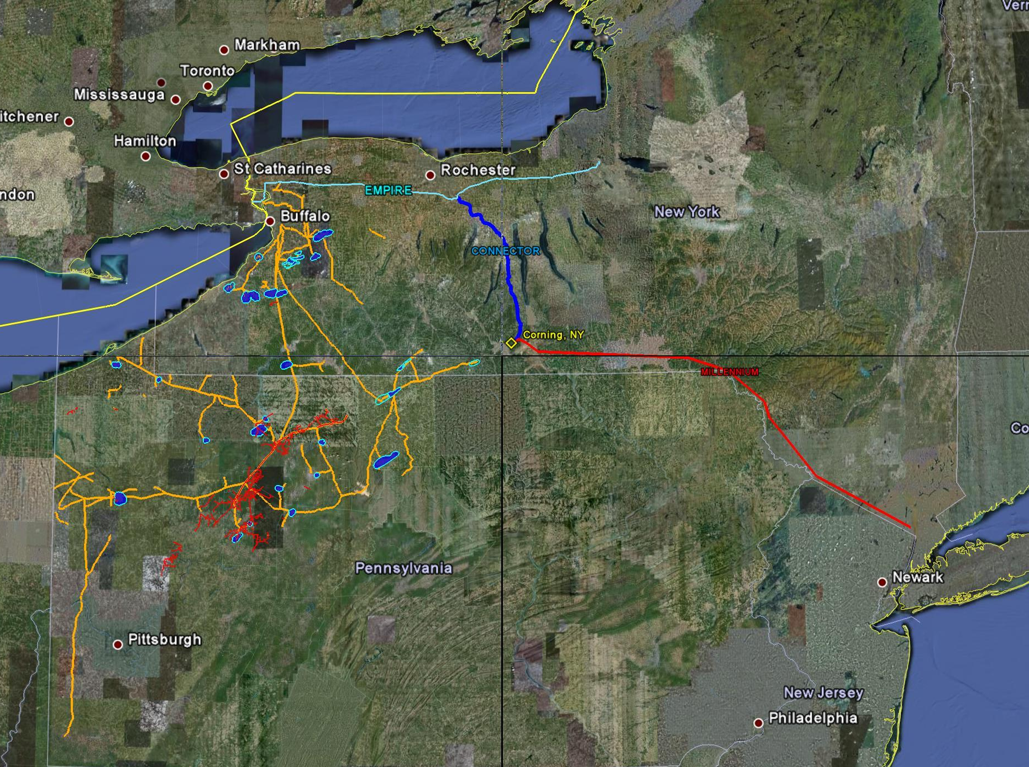
Canada
C
C
New England
C
C
C
Northern Access – Phase I & II
Tioga County
Covington
C
Lamont – Phase I & II
C
Bradford County
C
Y-M53
Trout Run
C
C
NYC Area
C
West to East
Upstream
Mid-Atlantic
C
Line N – Phase I & II

Slide 59
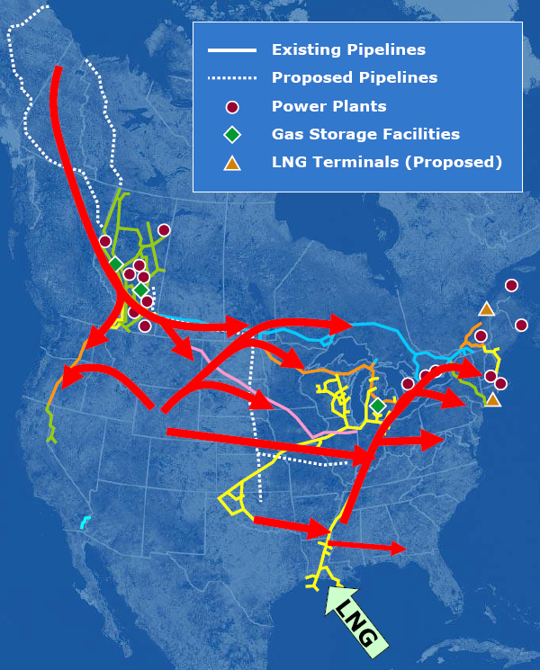
Flow Patterns Will Change
Key Messages
Flow patterns will shift
Through 2011 LNG will play a limited role in US supply mix
Canadian supplies will continue to decline in importance
Continued supply build up in Rockies & SE Supply Area may fill pipelines by 2009 causing bearish price trends in those regions
Pennsylvania will become a net exporter of Natural Gas
Marcellus Shale Production will play an increased role in overall supply to Northeast and Canada

Slide 60
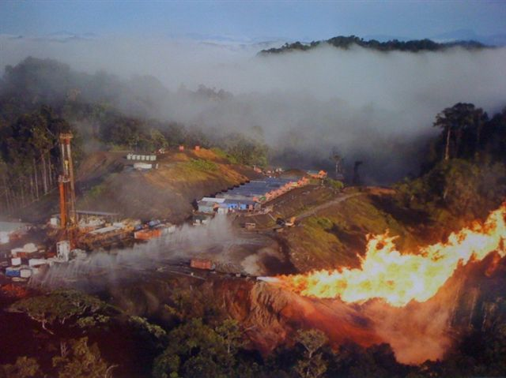
Questions?

